Slide 1


SkillLens: Student Placement Intelligence System Using Data Warehousing and Data Mining
CSA1606 – Data Warehousing and Data Mining
Presented by:
HARESH KUMAR N L – 192425009
AJAY I – 192421147
SAKTHI KAILASH T – 192411068
Guided by:
Dr Renuga S
Professor / CSE

Slide 2
ABSTRACT
The Student Placement Intelligence System is a Data Warehousing and Data Mining project designed to analyze student academic, skill, internship, and placement data. The system uses ETL techniques to clean and transform the data and stores it in a structured MySQL data warehouse using a Star Schema for efficient analysis.
Data mining techniques such as Decision Tree, K-Means Clustering, and Apriori Association Rule Mining are applied to predict placement outcomes and discover useful patterns. Power BI is used to create interactive dashboards and reports, while a Flask-based web application provides an easy interface for viewing student information, predictions, analysis, and placement reports.

Slide 3
OBJECTIVES
Problem Statement:
Educational institutions collect large volumes of placement-related data, but the information is often fragmented across multiple systems. This makes it difficult to identify placement trends, evaluate student performance, and predict employability. An integrated Data Warehousing and Data Mining solution is required to transform raw student data into meaningful insights that support academic planning and placement decisions.
Expected Outcomes:
Centralized Student Placement Data Warehouse.
Accurate placement prediction model.
Student segmentation based on placement readiness.
Identification of factors influencing placement.
Interactive Power BI dashboards for real-time analysis.
Improved decision-making for students and placement coordinators.

Slide 4
LITERATURE REVIEW
Author(s) & Year | Methodology | Key Findings | Research Gap / Contribution
Yağcı (2022) | Educational Data Mining using Machine Learning | Demonstrated that machine learning models effectively predict student academic performance using educational datasets. | Focused on academic performance prediction; did not integrate data warehousing or business intelligence dashboards. (Springer)
Bilal et al. (2022) | Feature Analysis with Machine Learning | Showed that demographic and academic attributes significantly influence prediction accuracy. | Did not include placement analytics or visualization using Power BI. (Nature)
Khairy et al. (2024) | Classification Algorithms (Decision Tree, Random Forest, Naïve Bayes, KNN, Neural Networks) | Random Forest and Decision Tree achieved high accuracy in predicting student performance. | Focused on examination performance rather than employability or placement prediction. (Springer)
Ahmed et al. (2024) | Decision Tree-based Educational Data Mining | Decision Tree effectively identified influential academic and demographic factors affecting student outcomes. | Does not provide an integrated Data Warehouse, ETL process, or interactive reporting. (Syddansk Universitet)
Proposed System (2026) | ETL + Data Warehouse + Decision Tree + K-Means + Apriori + Power BI | Integrates data warehousing, data mining, and business intelligence for student placement prediction and analytics. | Provides an end-to-end decision support system with centralized storage, predictive analytics, clustering, association rules, and interactive dashboards.

Slide 5
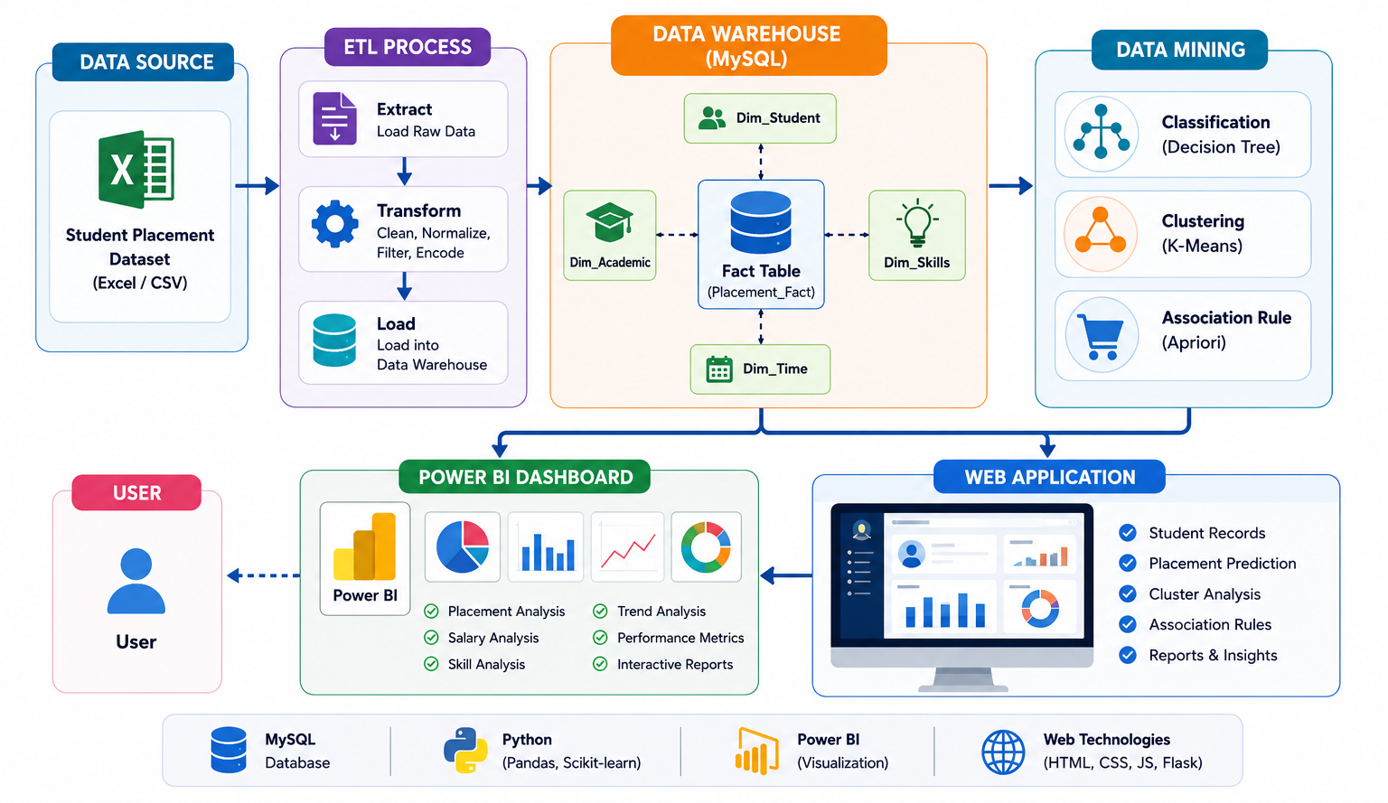
ARCHITECTURE DIAGRAM

Slide 6
LIST OF MODULES
Module 1: Data Collection & ETL
Module 2: Data Warehouse Design
Module 3: Data Mining & Placement Prediction
Module 4: Analytics & Power BI Dashboard
Module 5: Web Application & Reporting

Slide 7
Module 1: Data Collection & ETL
Function
Import the student placement dataset from Excel/CSV.
Analyze the available attributes and data types.
Remove duplicate records.
Handle missing and inconsistent values.
Transform and standardize the data.
Prepare clean data for the data warehouse.
Load the processed data into MySQL.
Technologies Used
Python – ETL implementation
Pandas – Data loading and cleaning
NumPy – Numerical processing
OpenPyXL – Excel file handling
MySQL – Loading processed data

Slide 8
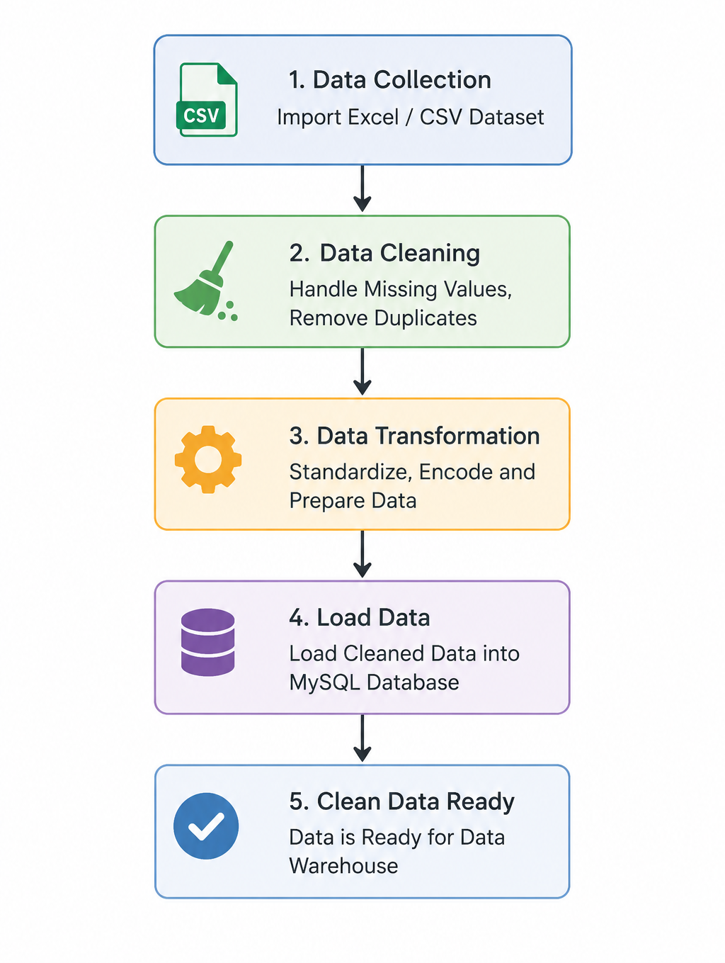

Slide 9
Module 2: Data Warehouse Design
Function
Convert the cleaned data into a structured data warehouse.
Design a Star Schema.
Create Fact and Dimension tables.
Establish primary-key and foreign-key relationships.
Store student placement information for analytical queries.
Support OLAP operations such as:
Roll-up
Drill-down
Slice
Dice
Technologies Used
MySQL – Data warehouse database
MySQL Workbench – Database and schema design

Slide 10
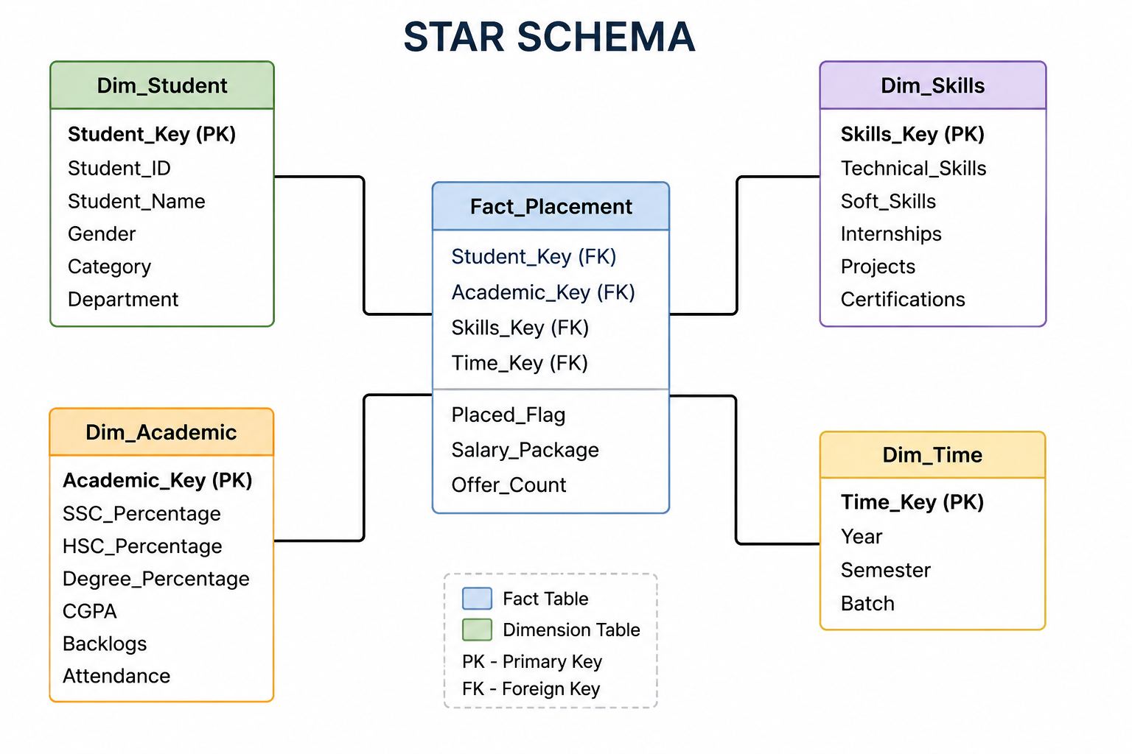

Slide 11
Module 3: Data Mining & Placement Prediction
Technologies Used
Python – Data mining implementation
Scikit-learn – Machine learning
Decision Tree – Placement classification
K-Means – Student clustering
MLxtend – Association rule mining
Apriori – Discovering placement-related associations
Function
Discover hidden patterns in student placement data.
Predict whether a student is likely to be placed.
Group students according to their placement potential.
Identify relationships between academic performance, skills, internships, certifications, and placement.
Evaluate the performance of mining models.

Slide 12
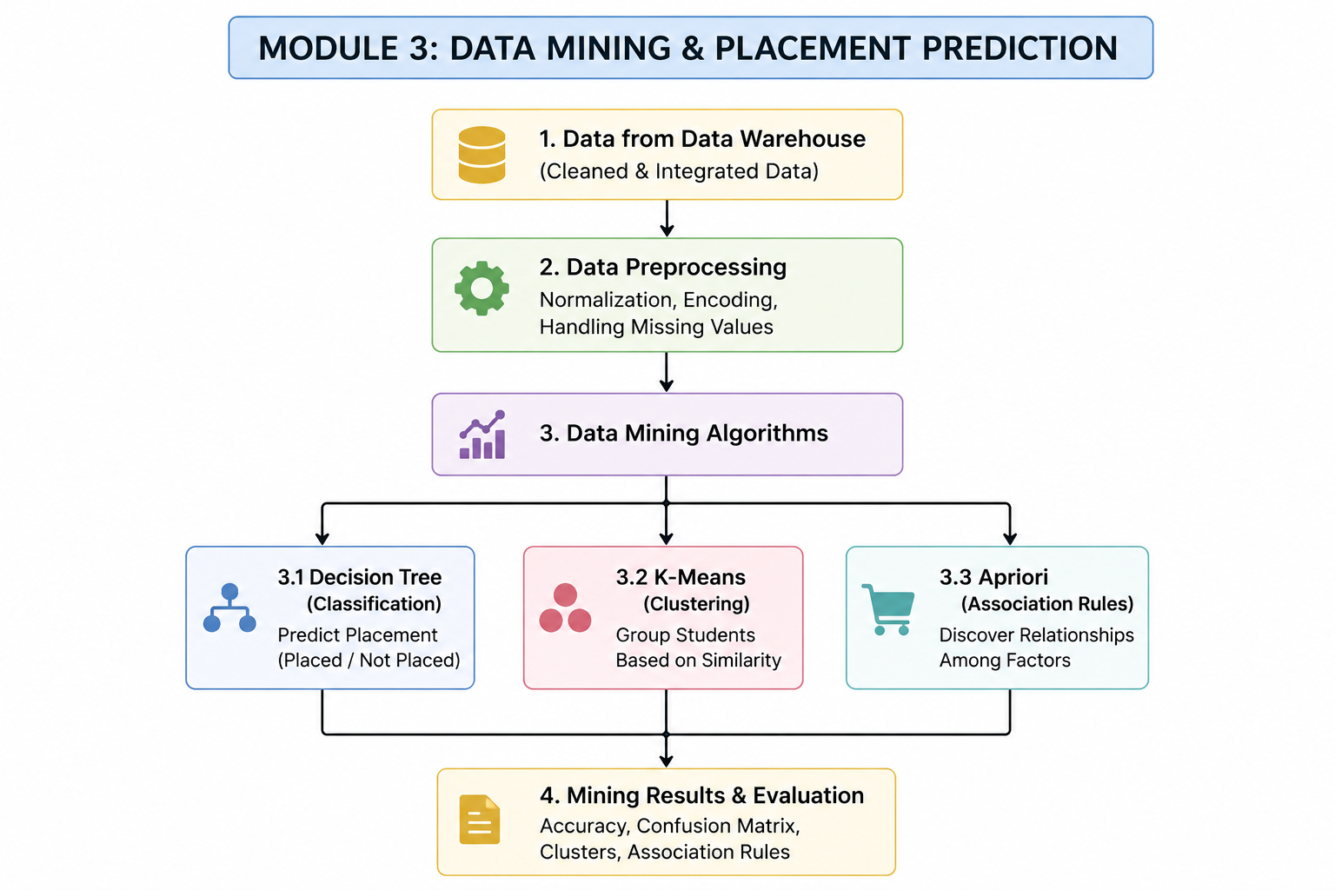

Slide 13
Module 4: Data Analytics & Power BI Visualization
Function
Connect the data warehouse to Power BI.
Create interactive placement analytics.
Display important KPIs.
Analyze placement trends and salary patterns.
Compare academic and skill-related factors.
Provide filters and slicers for interactive analysis.
Technologies Used
Microsoft Power BI – Dashboard and visualization
MySQL Connector – Connect Power BI with MySQL
DAX – Measures and calculated metrics
Power Query – Data transformation in Power BI

Slide 14
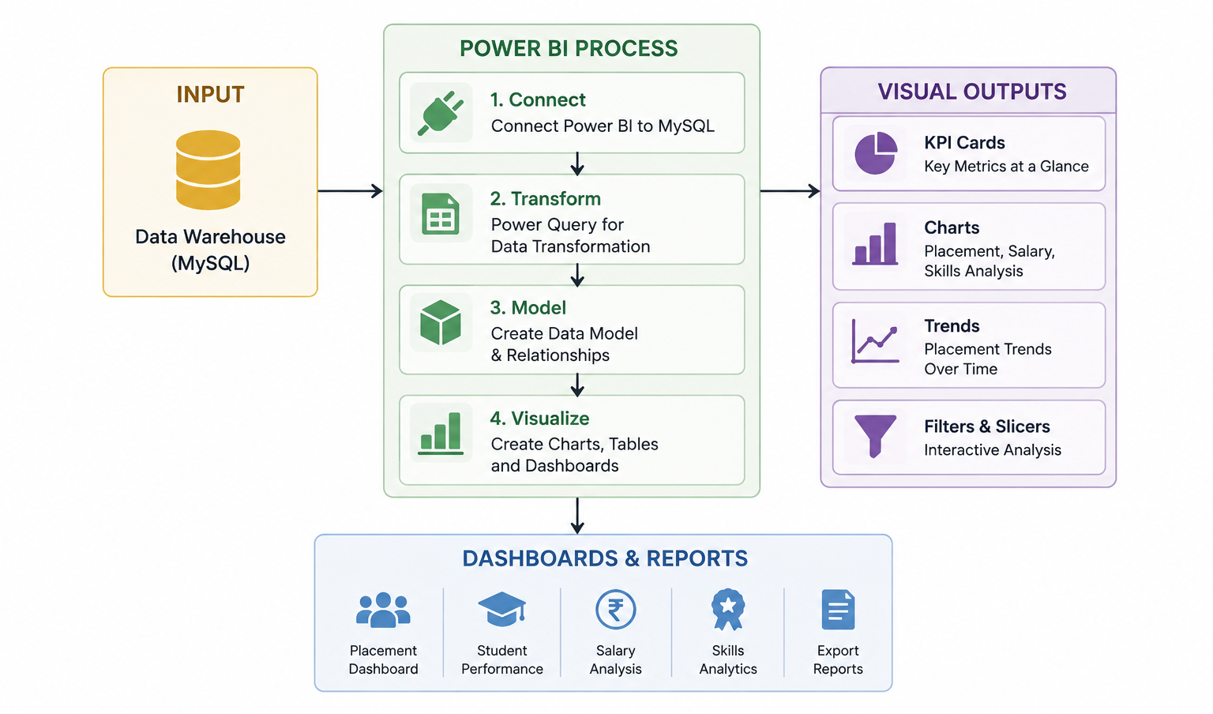

Slide 15
Module 5: Web Application & Reporting
Function
Develop a web-based interface for the placement system.
Display student records and placement statistics.
Provide placement prediction based on student details.
Generate student, placement, salary, and skill reports.
Provide interactive charts and dashboards for easy analysis.
Technologies Used
Python & Flask
HTML, CSS & Bootstrap
JavaScript & Chart.js
MySQL
Power BI

Slide 16
